Slide 1
CLASSIFICATION
Logistic Regression
K-Nearest Neighbors
Support Vector Machine
Kernel SVM
Naïve Bayes
Decision Tree
Random Forest

Slide 2
Project Brief
The objective is to build a classification model that predicts whether a customer is likely to purchase the product based on the Technical Suitability and Cost benefit incurred. This model will help the company optimize their client targeting strategy and improve their return on investment (ROI).
This will help the marketing team to focus better and present company in a suitable manner for conversion of deals into success
.
Business Objective:
The main business objective is to build a classification model that can predict whether a customer is likely to make a purchase after being targeted by the marketing team . By doing so, the company aims to identify potential customers who are more likely to convert and optimize their advertising budget to target those customers more effectively.

Slide 3
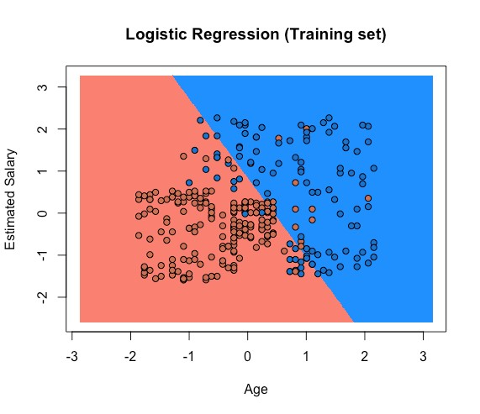
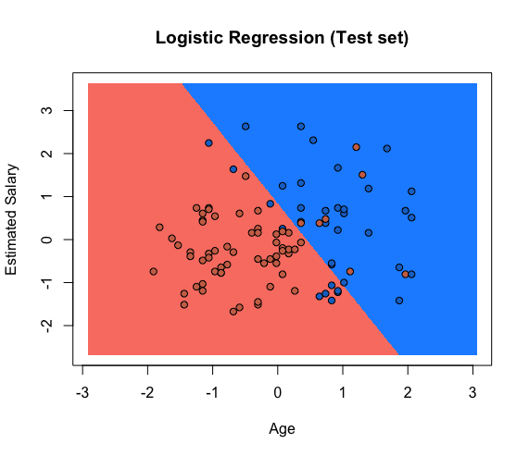
LOGISTIC REGRESSION
Technical Suitability
Technical Suitability
Cost benefit
Cost benefit

Slide 4
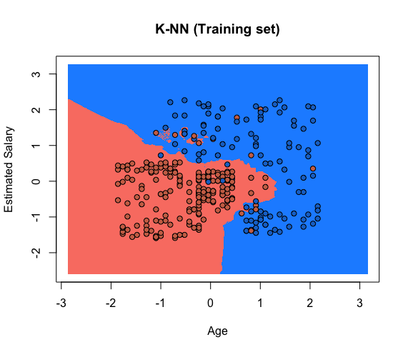
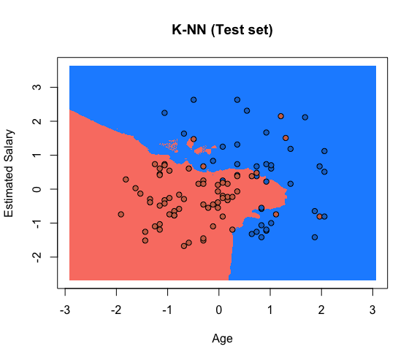

K-NEAREST NEIGHBORS
Cost benefit
Cost benefit

Slide 5
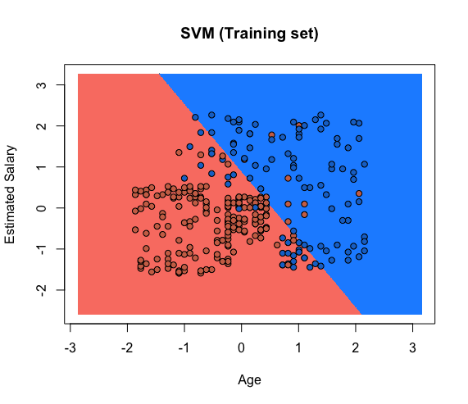
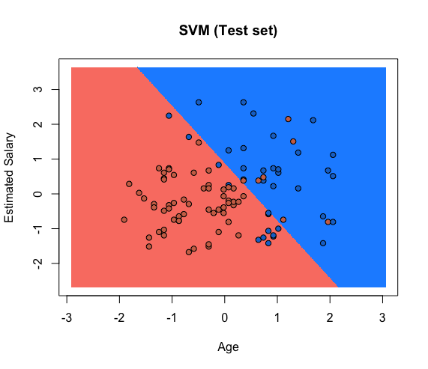
SUPPORT VECTOR MACHINE
Cost benefit
Cost benefit

Slide 6
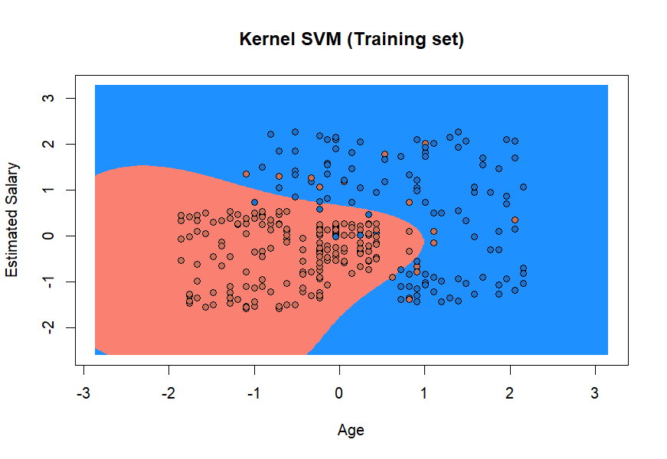
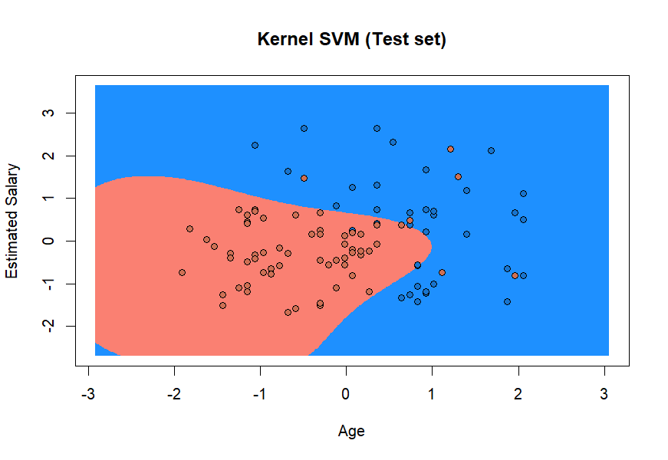
KERNEL SVM
Cost benefit
Cost benefit

Slide 7
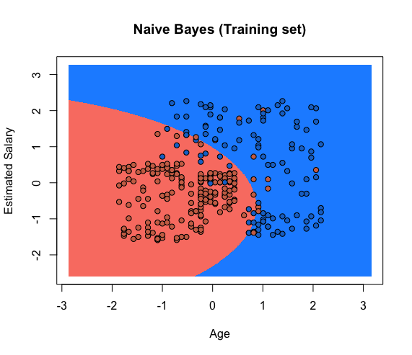
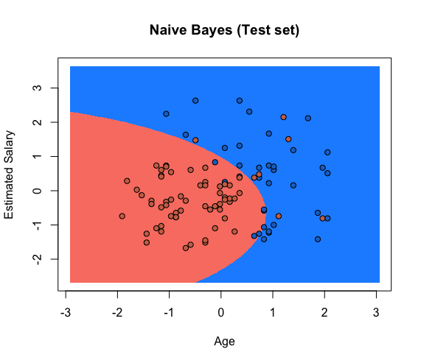
NAÏVE BAYES
Cost benefit
Cost benefit

Slide 8
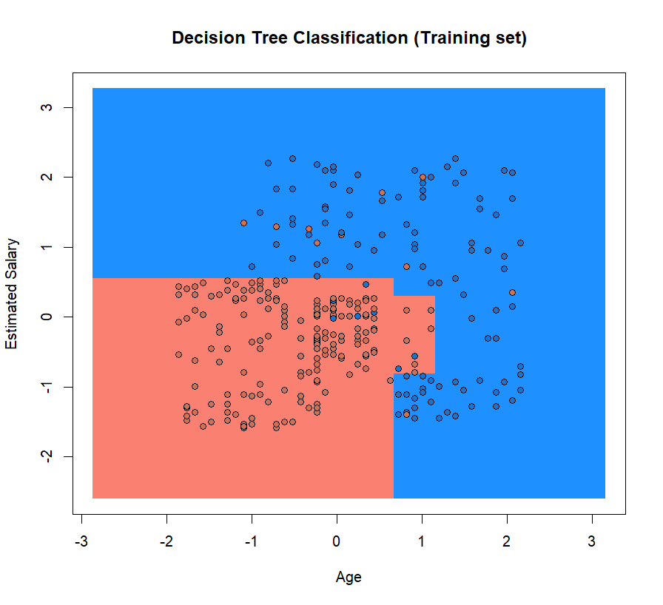
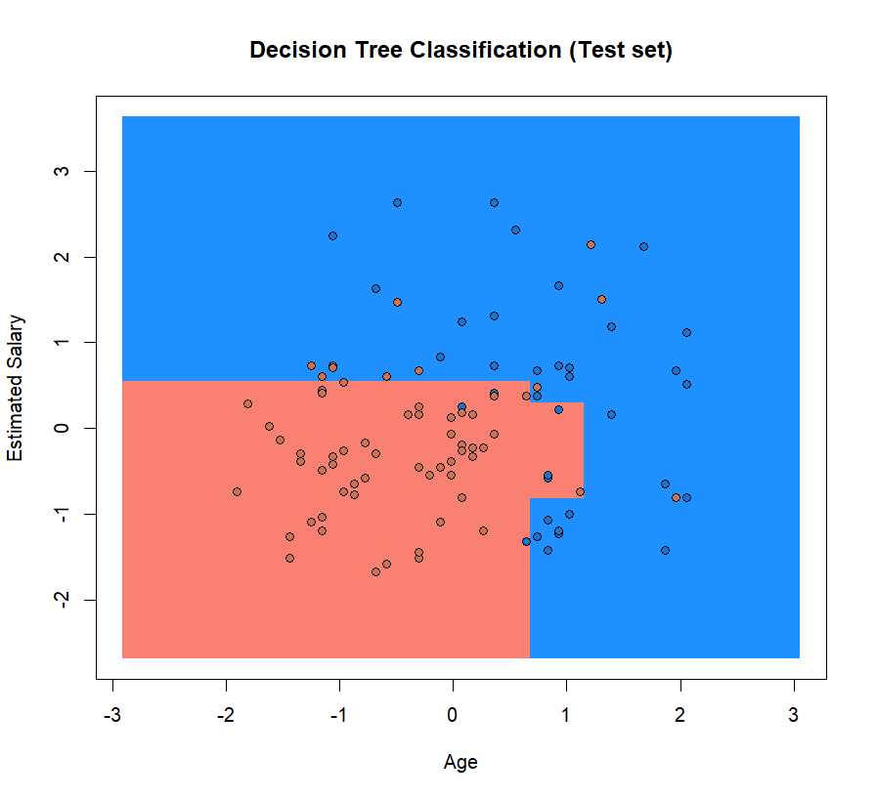
DECISION TREE
Cost benefit
Cost benefit

Slide 9
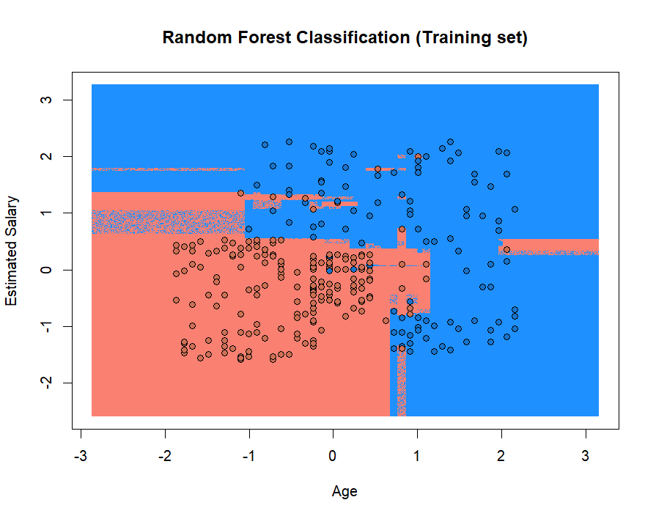
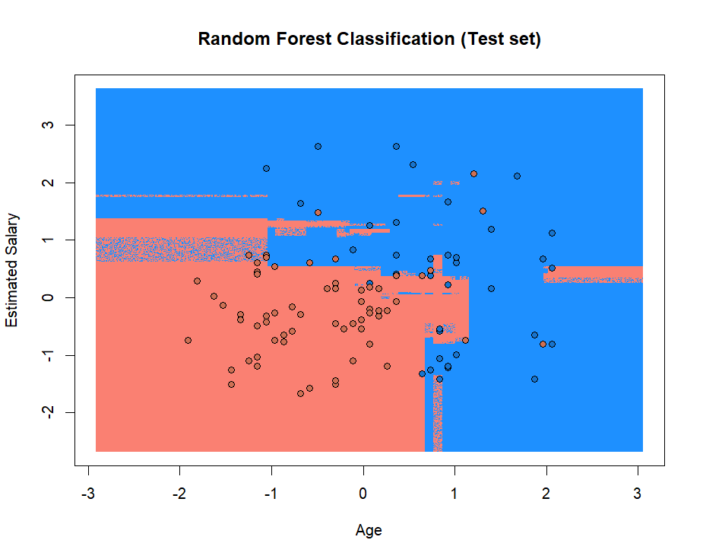
RANDOM FOREST
Cost benefit
Cost benefit

